Slide 1
Travel Ai agent
CAPSTONE PROJECT
Presented By: Rohit Ganesh Patil
Student name : Rohit Ganesh Patil
College Name & Department : Sies Graduate school of technology, AIML department

Slide 2
OUTLINE
Problem Statement
Technology used
Wow factor
End users
Result
Conclusion
Git-hub Link
Future scope
IBM Certifications

Slide 3
Problem Statement
Travel planning can be overwhelming and time-consuming. Travelers need detailed, day-wise itineraries including activities, dining, transport, and accommodation—personalized according to dates, budget, and interests. The Travel Planner Agent addresses this by leveraging AI to generate adaptable, user-centered trip plans, saving time and improving the overall travel experience.

Slide 4
Technology used
IBM cloud lite services
Natural Language Processing (NLP)
Retrieval Augmented Generation (RAG)
IBM Granite model

Slide 5
IBM cloud services used
IBM Cloud Watsonx AI Studio: For orchestrating the agent workflow
IBM Cloud Watsonx AI Runtime: For scalable deployment
IBM Cloud Agent Lab: For agent prototyping and management
IBM Granite Foundation Model: For advanced AI/LLM capabilities

Slide 6
Wow factors
Personalized, adaptive travel itineraries customized for each user—considering their budget, dates, interests, and group size for a perfect fit.
Detailed day-wise scheduling—breaking each day into morning, afternoon, and evening, with specific recommended activities, timings, and logical routing.
Integration of real-time data such as weather, local festivals/events, and the latest transport availability, ensuring itineraries are practical and up-to-date.
Interactive, conversational experience: Users can adjust preferences or dates on the fly and receive updated plans instantly.
Comprehensive recommendations: Not just top attractions, but also local hidden gems, eateries, hotels, and travel tips unique to each destination.
Built-in safety and cultural guidance: Suggestions include local customs, precautions, and seasonal advice to maximize enjoyment and minimize risk.
Multilingual, multi-modal flexibility: The agent is designed for future support of voice, text, and different languages, making it accessible worldwide.
Extensible and modular: Ready for integration with external booking and payment platforms for end-to-end travel planning.

Slide 7
End users
Independent travelers and families planning personal vacations.
Travel agencies looking to automate and enhance itinerary generation
Corporate event and offsite organizers.
Tourism boards aiming for interactive destination promotion.
Academic or educational tour planners managing group travel.

Slide 8
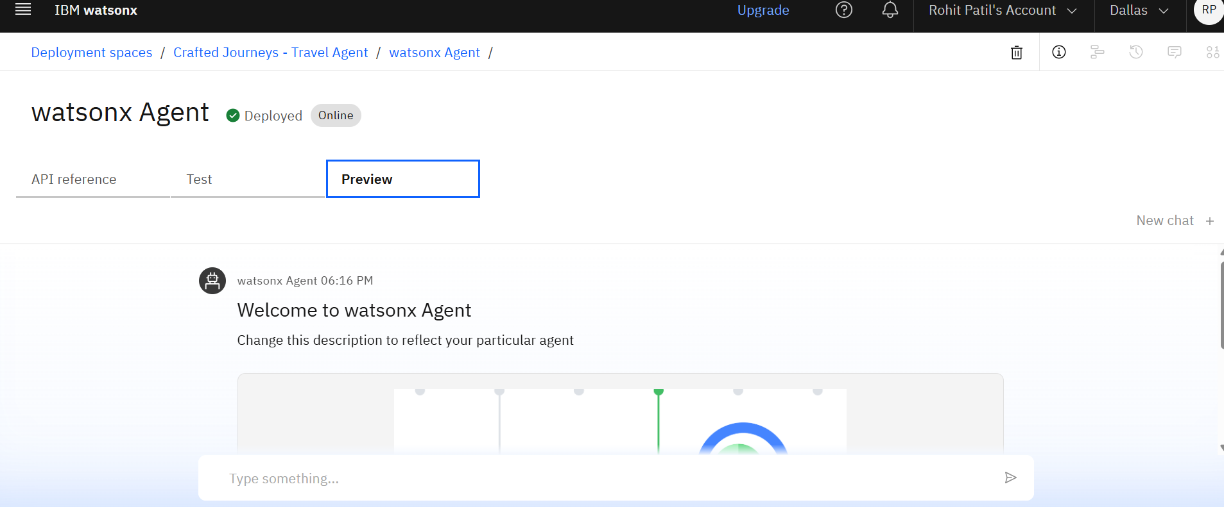
Results

Slide 9
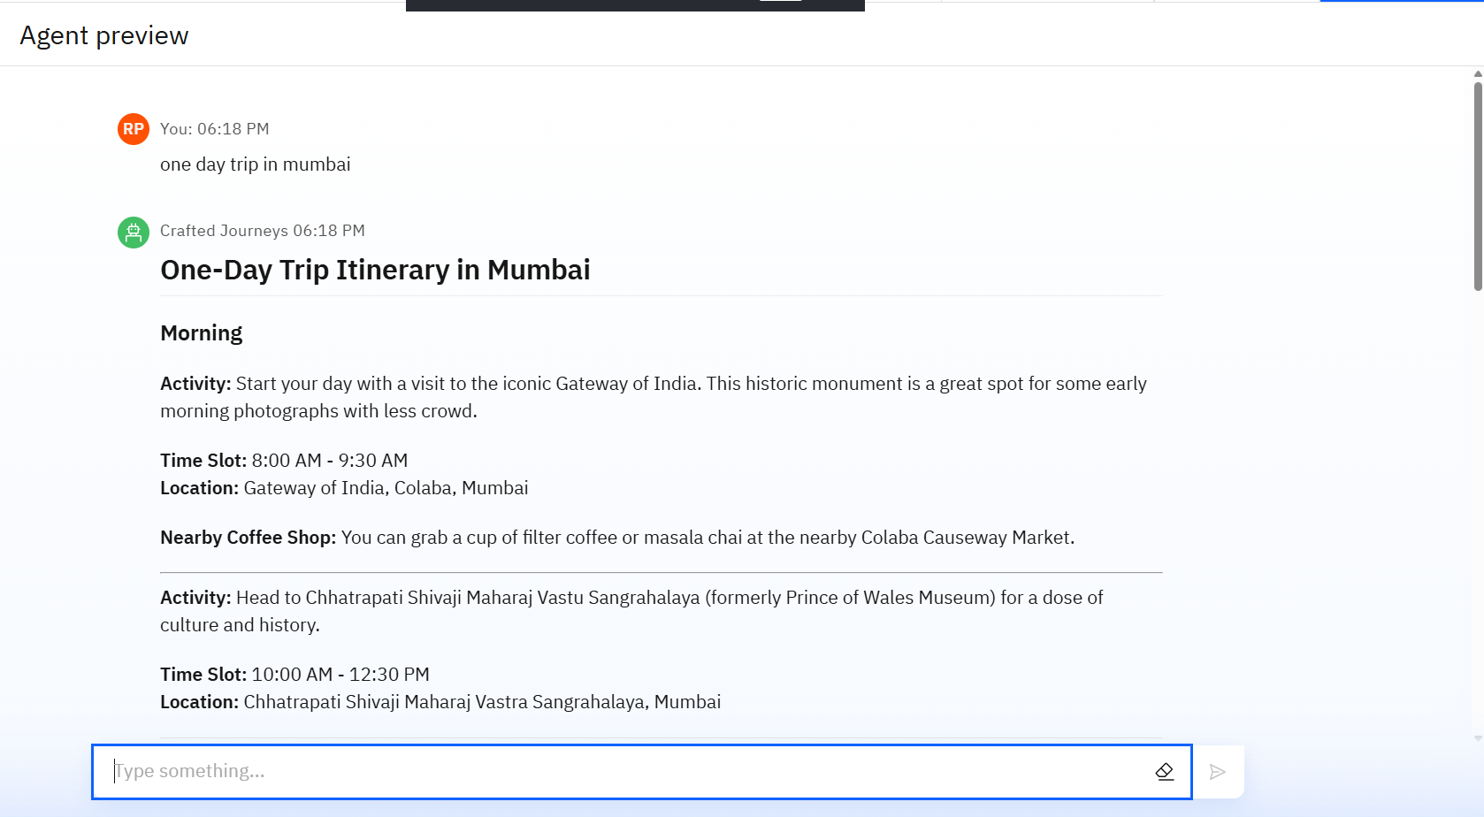
Results

Slide 10
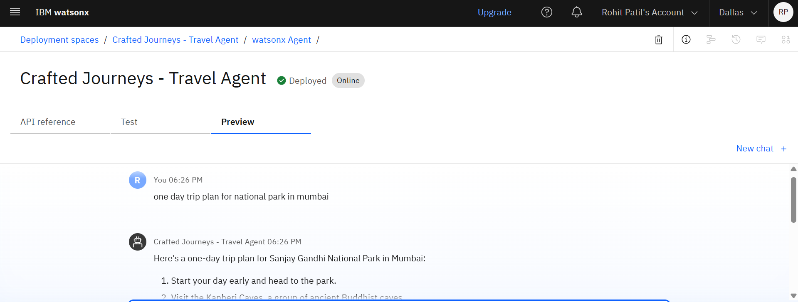
Results
Deployed AI Agent

Slide 11
Conclusion
The agent simplifies and personalizes the entire travel planning process, allowing users to generate detailed, day-wise itineraries effortlessly.
By leveraging IBM’s cloud-based AI and Retrieval-Augmented Generation, it delivers accurate, up-to-date, and context-aware recommendations for every trip.
Ultimately, the Travel Planner Agent saves users time, reduces planning stress, and ensures a more enjoyable and well-organized travel experience.

Slide 12
Future scope
Live integration with booking and reservation APIs for hotels, flights, and experiences.
Multi-modal expansion: support for travel photos, scanned tickets, and spoken input/output.
Smarter, self-improving recommendations using user feedback (reinforcement learning).
Instant notifications of weather events, closures, or delays to update plans proactively.
Collaboration: Dedicated features for planning and coordinating group trips, shared schedules, and custom requirements.

Slide 13
Github link
Travel agent project link - https://github.com/MasterRohitPatil/Travel_Agent-Ppt

Slide 14
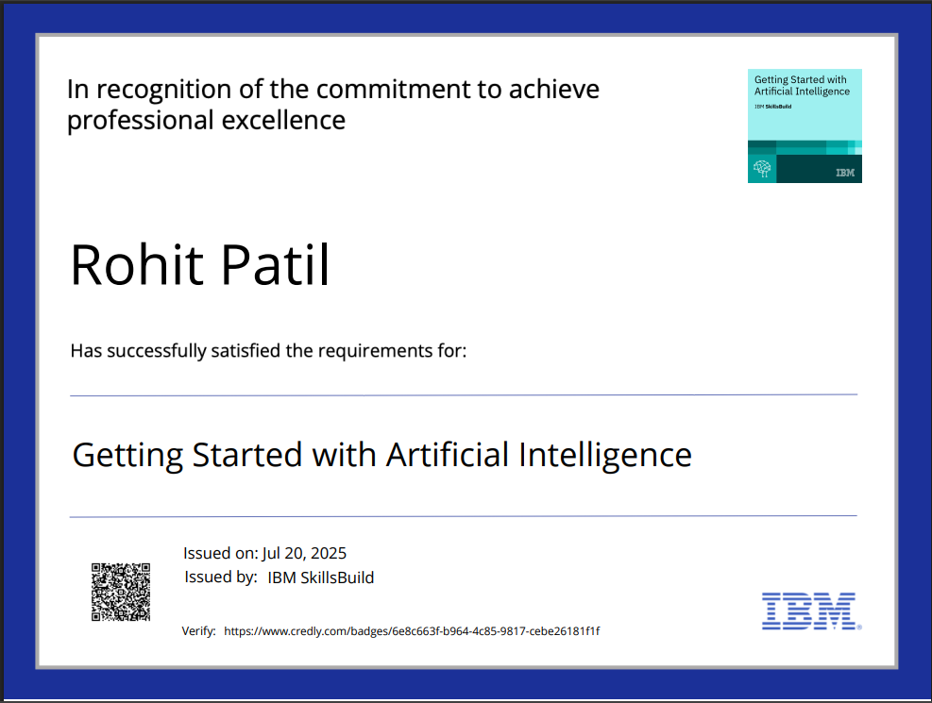
IBM Certifications

Slide 15
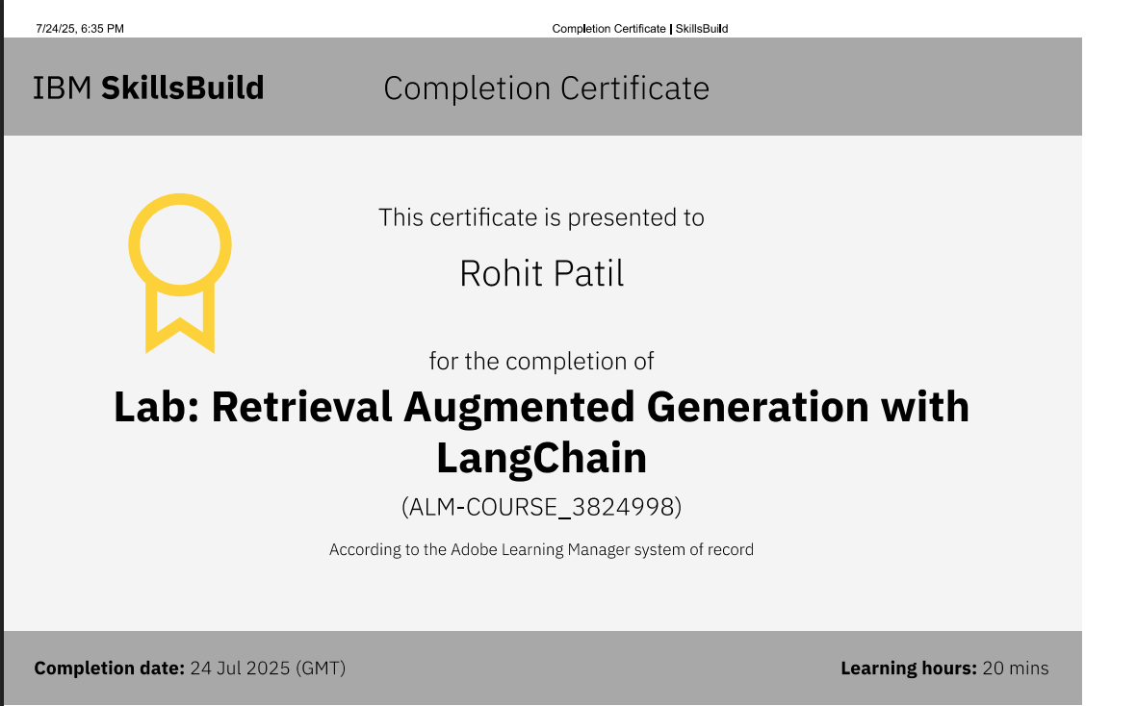

Slide 16
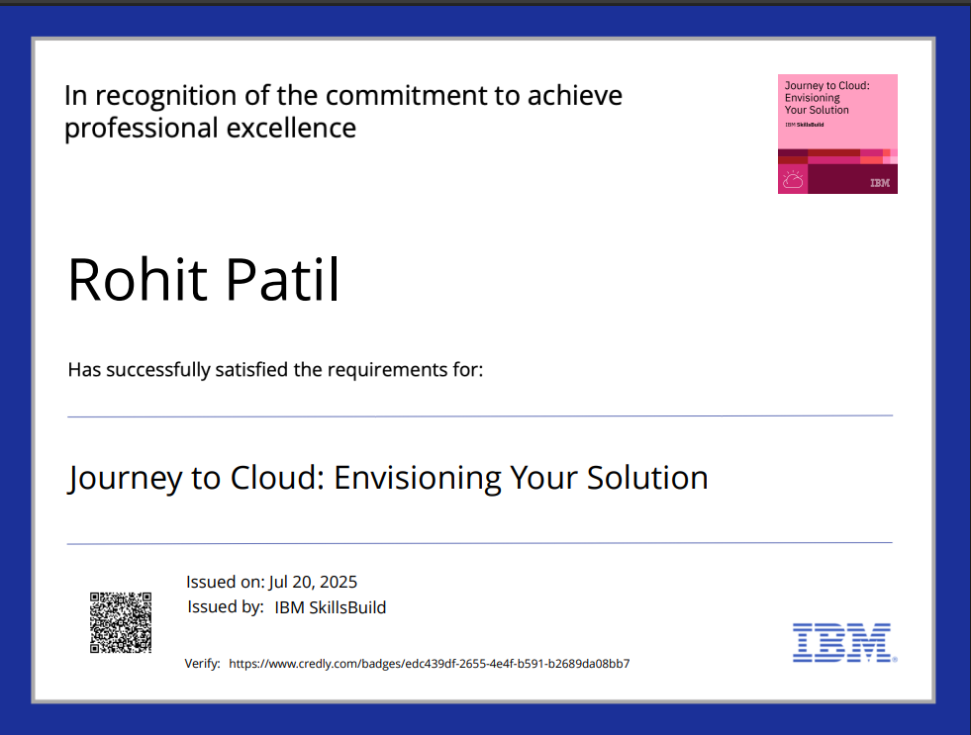

Slide 17
THANK YOU

